Slide 1

Learning Objectives
LO1 Explain the relationship between the accounts receivable ledger and its controlling account.
LO2 Record sales on account using a sales journal.
© 2014 Cengage Learning. All Rights Reserved.

Slide 2
Subsidiary Ledgers and Controlling Accounts
Lesson 10-1
LO1
The amount a business receives from the sale of an item of merchandise is called the selling price.
The amount a business adds to the cost of merchandise to establish the selling price is called markup.
An accounts receivable ledger is a subsidiary ledger containing all accounts for charge customers.

Slide 3
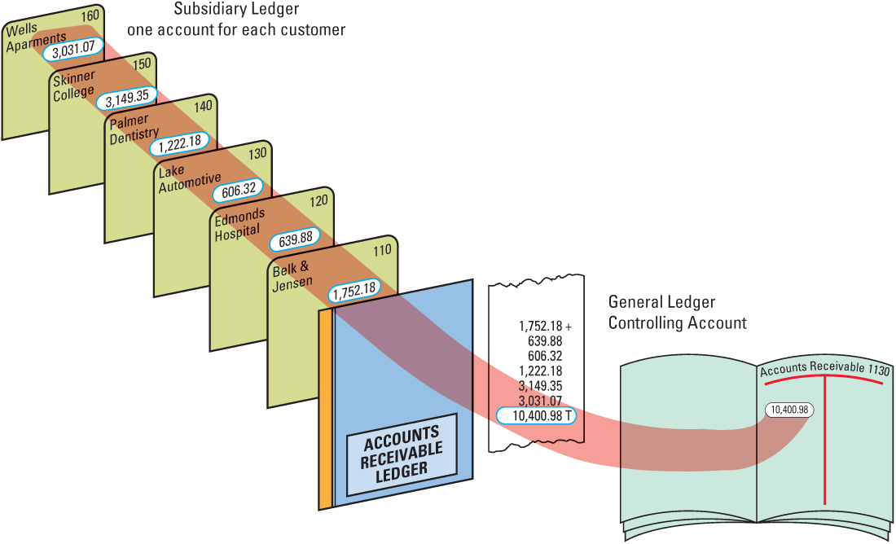
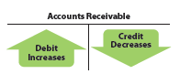
Subsidiary Ledgers and Controlling Accounts
Lesson 10-1
LO1

Slide 4
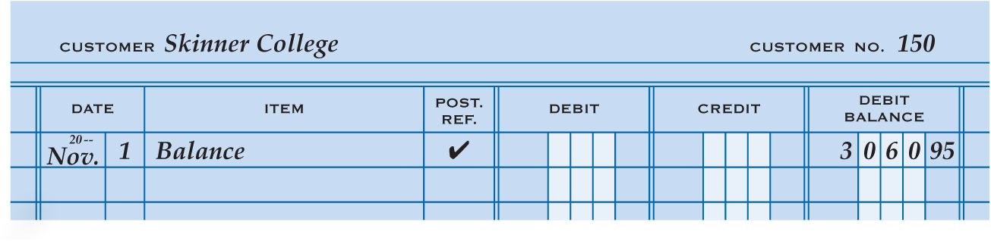
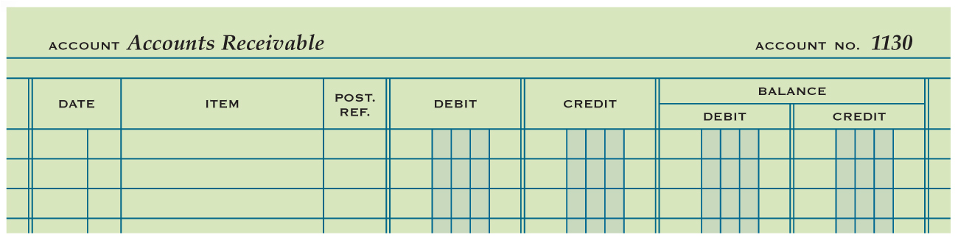
Subsidiary Ledger Form
Lesson 10-1
LO1
1
Account Name
2
Account Number
Date
3
4
Balance
5
Check Mark
6
Account Balance
Same column headings

Slide 5
Sales Tax
Lesson 10-1
LO2
A tax on a sale of merchandise or services is called a sales tax.

Slide 6
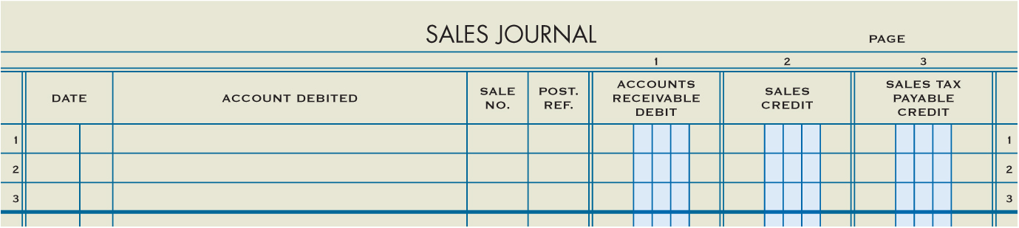
Sales Journal
Lesson 10-1
LO2
A sales journal is a special journal used to record only sales of merchandise on account.

Slide 7
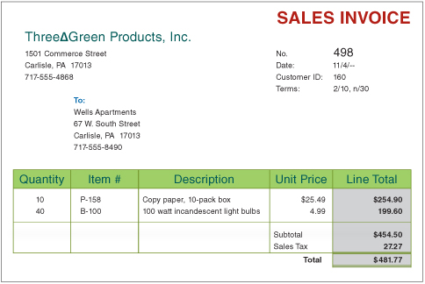
Sales Invoice
Lesson 10-1
LO2

Slide 8
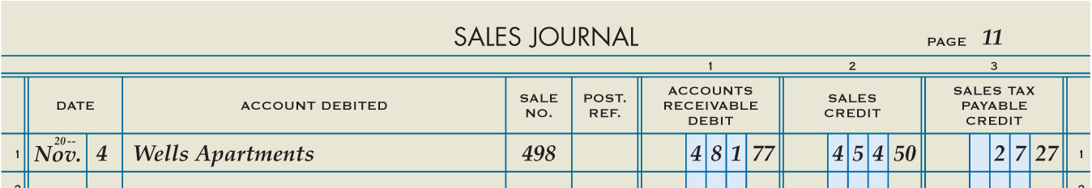
Sale on Account
Lesson 10-1
LO2
November 4. Sold merchandise on account to Wells Apartments, $454.50, plus sales tax, $27.27; total, $481.77. Sales Invoice No. 498.
Accounts Receivable
481.77
Sales
454.50
Sales Tax Payable
1
Date
2
Customer Name
3
Sales Invoice Number
27.27
Total Amount Owed by Customer
4
5
Sales
6
Sales Tax

Slide 9

Lesson 10-1 Audit Your Understanding
Lesson 10-1
1. How are selling price and markup related?
ANSWER
Markup is the amount added to the cost of merchandise to set the selling price.

Slide 10
Lesson 10-1 Audit Your Understanding
Lesson 10-1
2. What is the relationship between the accounts receivable ledger and its controlling account?
ANSWER
The total of the accounts in the accounts receivable subsidiary ledger equals the balance in the controlling account, Accounts Receivable.

Slide 11
Lesson 10-1 Audit Your Understanding
Lesson 10-1
3. What column on a general ledger form is not on an accounts receivable ledger form?
ANSWER
Credit Balance

Slide 12
Lesson 10-1 Audit Your Understanding
Lesson 10-1
4. What is the title of the general ledger account used to summarize the total amount due from all charge customers?
ANSWER
Accounts Receivable

Slide 13
Lesson 10-1 Audit Your Understanding
Lesson 10-1
5. How are sales tax rates usually stated?
ANSWER
As a percent of sales

Slide 14
Lesson 10-1 Audit Your Understanding
Lesson 10-1
6. Why is sales tax collected considered a liability?
ANSWER
The amount of sales tax collected is a business liability until paid to the government.

Slide 15
Work Together 10-1 On You Own 10-1
Work Together
10-1 thru 10-4 work (Excel)
Modeled
Page 289
Use
10-1 - 10-4 AR Led work (tab)
10-1 - 10-4 SJ & CR Jrnl work (tab)
On Your Own
10-1 thru 10-4 own (Excel)
Complete
Page 289
Use
10-1 - 10-4 AR Led own (tab)
10-1 - 10-4 SJ&CR Jrnl own (tab)

Slide 16

Learning Objectives
LO3 Post sales on account to an accounts receivable ledger and a general ledger.
© 2014 Cengage Learning. All Rights Reserved.

Slide 17

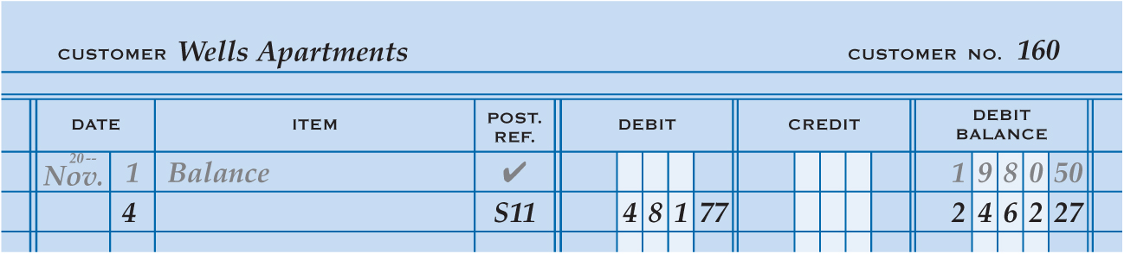
Posting from a Sales Journal to an Accounts Receivable Ledger
Lesson 10-2
LO3
2
1
3
5
4
1. Write the date in the Date column of the vendor account.
2. Write the sales journal page number in the Post. Ref. column of the account.
3. Write the debit amount in the Debit column of the customer account.
4. Add the amount in the Debit column to the previous balance in the Debit Balance column and write the new account balance in the Debit Balance column.
5. Write the customer number in the Post. Ref. column of the sales journal.

Slide 18
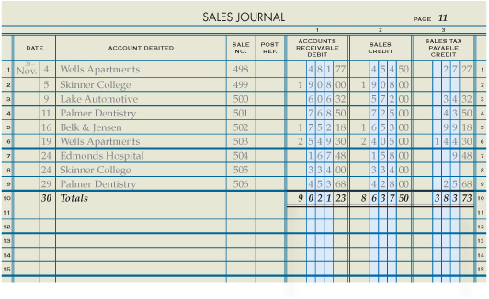
Totaling, Proving, and Ruling a Sales Journal
Lesson 10-2
LO3
2
Date
3
“Totals”
Single Rule
Column Totals
Double Rule
1
4
5

Slide 19
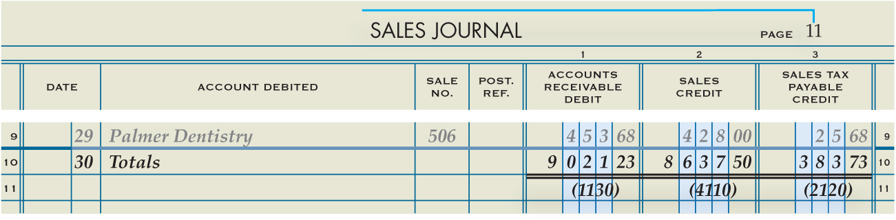
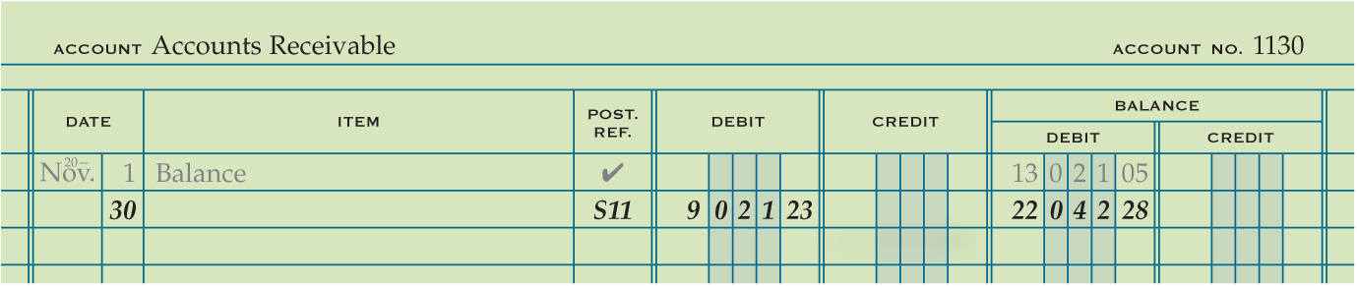
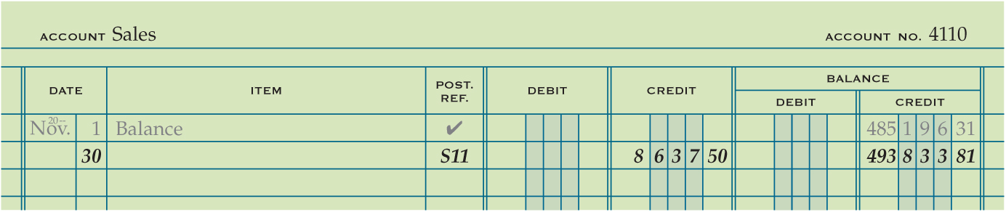
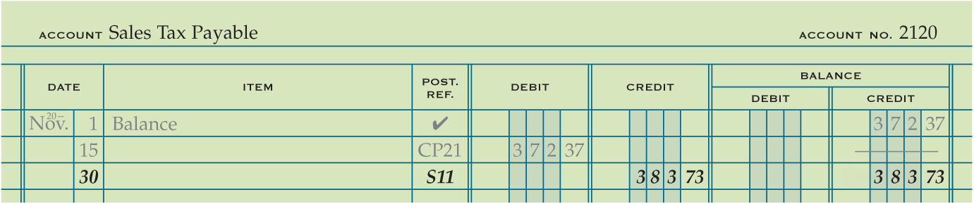
Posting Totals of a Sales Journal to a General Ledger
Lesson 10-2
LO3
Date
Journal Number
Debit or Credit
Account Number
1
2
3
5
4
Account Balance
5
1
2
3
4
5
1
2
3
4

Slide 20
Lesson 10-2 Audit Your Understanding
Lesson 10-2
1. What accounts are impacted, and how, by the posting of the special columns of a sales journal?
ANSWER
1. Accounts Receivable is debited.
2. Sales is credited.
3. Sales Tax Payable is credited.

Slide 21
Lesson 10-2 Audit Your Understanding
Lesson 10-2
2. List the five steps for posting transactions to accounts receivable ledger forms.
ANSWER
1. Write the date.
2. Write the sales journal page number in the Post. Ref. column of the ledger account.
3. Enter the debit and credit amounts.
4. Calculate and record the new account balance.
5. Write the customer account number in the Post. Ref. column of the sales journal.

Slide 22
Work Together 10-2 On You Own 10-2
Work Together
10-1 thru 10-4 work (Excel)
Modeled
Page 293
Use
All 3 tabs
On Your Own
10-1 thru 10-4 own (Excel)
Complete
Page 293
Use
All 3 tabs

Slide 23

Learning Objectives
LO4 Record cash and credit card sales using a cash receipts journal.
LO5 Journalize cash receipts on account using a cash receipts journal.
© 2014 Cengage Learning. All Rights Reserved.

Slide 24
Processing Sales Transactions
Lesson 10-3
LO4
A sale in which the customer pays for the total amount of the sale at the time of the transaction is called a cash sale.
Credit card and debit card sales are treated as cash sales because the business receives its cash in a very short time.
A specialized computer used to collect, store, and report all the information about a sales transaction is called a point-of-sale (POS) terminal.
The report that summarizes the cash and credit card sales of a point-of-sale terminal is called a terminal summary.

Slide 25
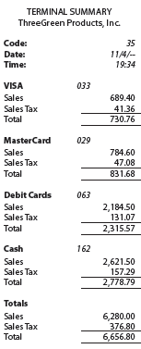
Terminal Summary
Lesson 10-3
LO4

Slide 26
Processing Credit Cards
Lesson 10-3
LO4
Sales information for credit card sales is stored in the POS terminals.
A report of credit card sales produced by a point-of-sale terminal is called a batch report.
A batch report can be detailed, showing every credit card sale.
Or, the batch report can be a summary, showing only the number and total of sales by credit card type.
The process of preparing a batch report from a point-of-sale terminal is called batching out.

Slide 27
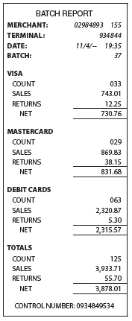
Batch Report
Lesson 10-3
LO4

Slide 28
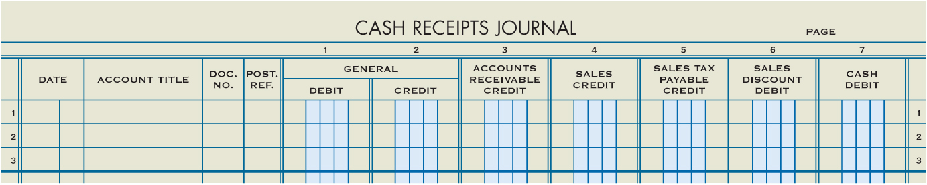
Cash Receipts Journal
Lesson 10-3
LO4
A cash receipts journal is a special journal used to record only cash receipt transactions.
A cash discount on a sale taken by the customer is called a sales discount.
.

Slide 29
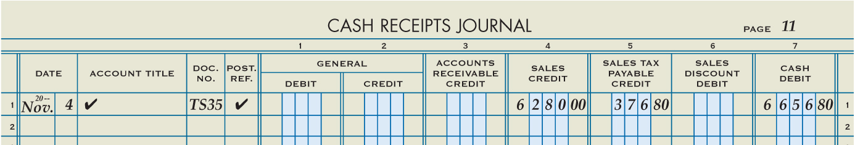
Cash and Credit Card Sales
Lesson 10-3
LO4
Cash
November 4. Recorded cash and credit card sales, $6,280.00, plus sales tax, $376.80; total, $6,656.80. Terminal Summary 35.
6,656.80
Sales
6,280.00
Date
Terminal Summary Number
Sales Tax Payable
1
3
376.80
2
4
5
6
7
Check Mark
Check Mark
Sales
Sales Tax Payable
Cash

Slide 30
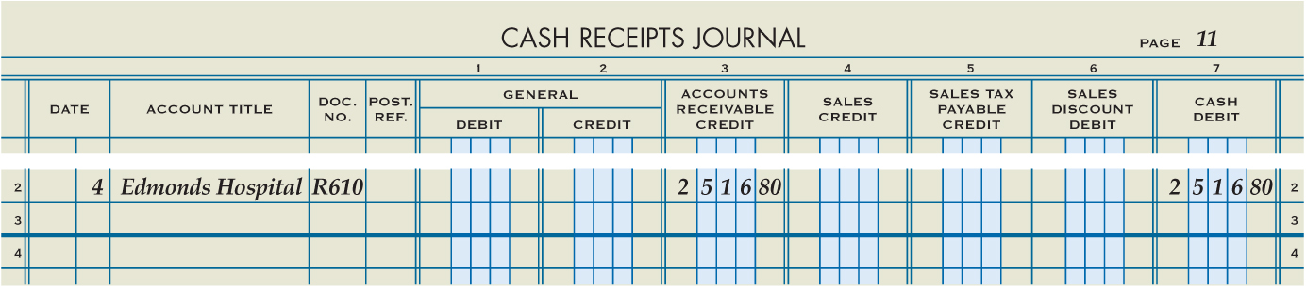
Cash Receipts on Account
Lesson 10-3
LO5
Cash
November 4. Received cash on account from Edmonds Hospital, $2,516.80, covering S448. Receipt No. 610.
2,516.80
Accounts Receivable
2,516.80
2
Customer’s Name
1
Date
3
Receipt Number
4
Sales Invoice Amount
Cash Received
5

Slide 31
Calculating Cash Receipts on Account with Sales Discount
Lesson 10-3
LO5
Sales
Invoice
Amount
Sales Discount Rate
Sales Discount
×
=
$1,450.00
×
2%
=
$29.00

Slide 32
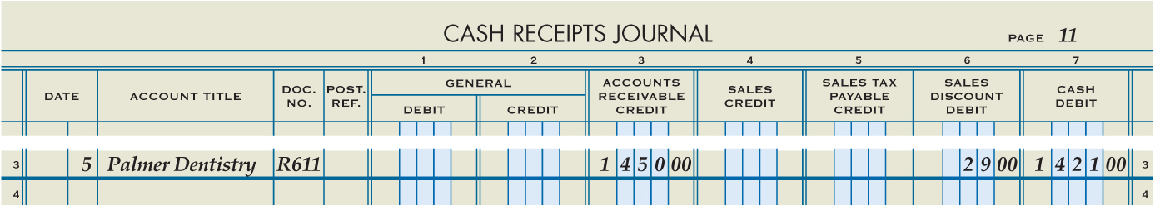
Journalizing Cash Receipts on Account with Sales Discounts
Lesson 10-3
LO5
Cash
November 5. Received cash on account from Palmer Dentistry, $1,421.00, covering Sales Invoice No. 462 for $1,450.00, less 2% discount, $29.00. Receipt No. 611.
1,421.00
Accounts Receivable
1,450.00
Sales Discount
29.00
2
Customer’s Name
4
Original Sales Amount
1
Date
3
Receipt Number
Sales Discount
5
6
Cash Received

Slide 33
Lesson 10-3 Audit Your Understanding
Lesson 10-3
1. How does a POS terminal determine the price of an item?
ANSWER
Before any sale is entered, the number, description, price, and quantity on hand of each item of merchandise are stored in the POS terminal.

Slide 34
Lesson 10-3 Audit Your Understanding
Lesson 10-3
2. What are the two types of batch reports?
ANSWER
A batch report can be detailed, showing each credit card sale, or a summary of the number and total of sales by credit card type.

Slide 35
Lesson 10-3 Audit Your Understanding
Lesson 10-3
3. What is meant by 2/10, n/30 credit terms?
ANSWER
If a customer pays the amount owed within 10 days, the sales invoice amount is reduced 2%. Otherwise, the net amount is due in 30 days.

Slide 36
Work Together 10-3 On You Own 10-3
Work Together
10-1 thru 10-4 work (Excel)
Modeled
Page 301
Use
10-1 - 10-4 SJ & CR Jrnl work (tab)
On Your Own
10-1 thru 10-4 own (Excel)
Complete
Page 301
Use
10-1 - 10-4 SJ&CR Jrnl own (tab)

Slide 37

Learning Objectives
LO6 Post cash receipts to an accounts receivable ledger and a general ledger.
LO7 Prepare a schedule of accounts receivable.
© 2014 Cengage Learning. All Rights Reserved.

Slide 38
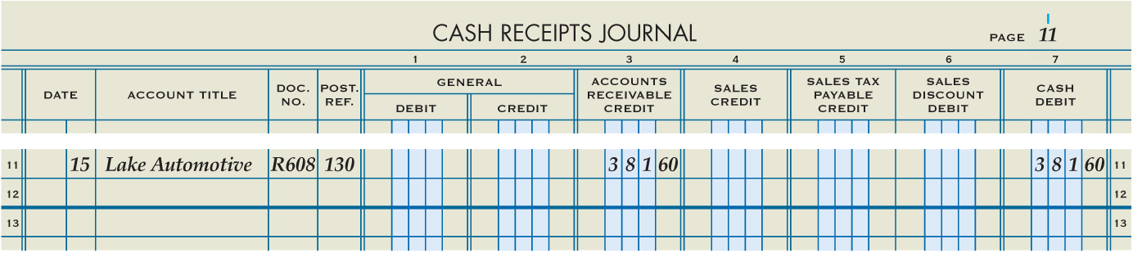
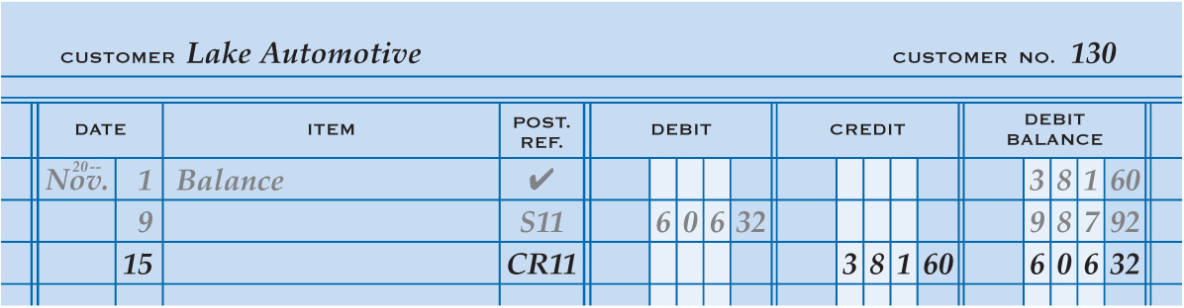
Posting from a Cash Receipts Journal to an Accounts Receivable Ledger
Lesson 10-3
LO6
Journal Page Number
2
Date
1
Credit
3
5
Customer Number
Account Balance
4

Slide 39
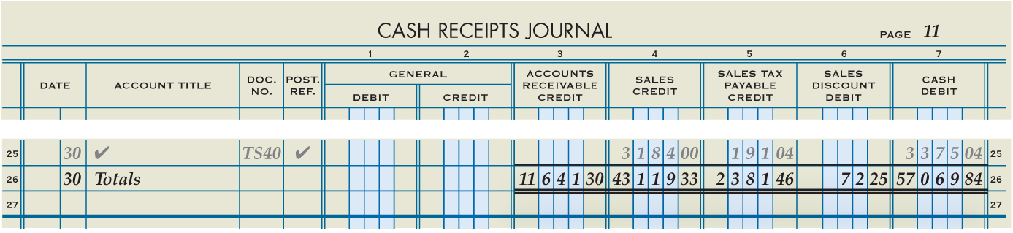
Totaling, Proving, and Ruling a Cash Receipts Journal
Lesson 10-3
LO6
Column Title | Debit Totals | Credit Totals
General Debit ………………........ | ―
General Credit …………………….. |  | ―
Accounts Receivable Credit …. |  | $11,641.30
Sales Credit ………………..... ...... |  | 43,119.33
Sales Tax Payable Credit……... |  | 2,381.46
Sales Discount Debit....…........ | $ 72.25
Cash Debit……………….............. | 57,069.84
Totals………………...................... | $57,142.09 | $57,142.09

Slide 40
Proving Cash at the End of a Month
Cash on hand at the beginning of the month ...................... $18,941.69
(Nov. 1 balance of general ledger cash account)
Plus total cash received during the month ........................... 57,069.84 (Cash Debit column total, cash receipts journal)
Equals total ............................................................................. $76,011.53
Less total cash paid during the month .................................. 23,546.38
(Cash Credit column total, cash payments journal)
Equals cash balance on hand at the end of the month ......... $52,465.15
Checkbook balance on the next unused check stub ............. $52,465.15

Slide 41
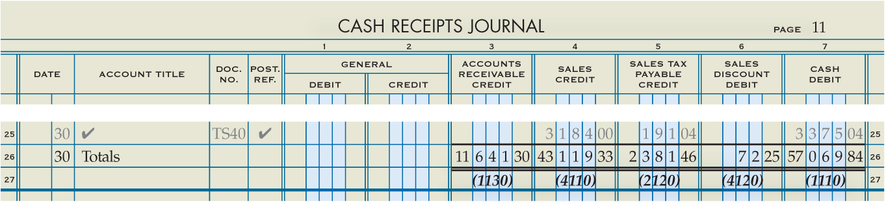
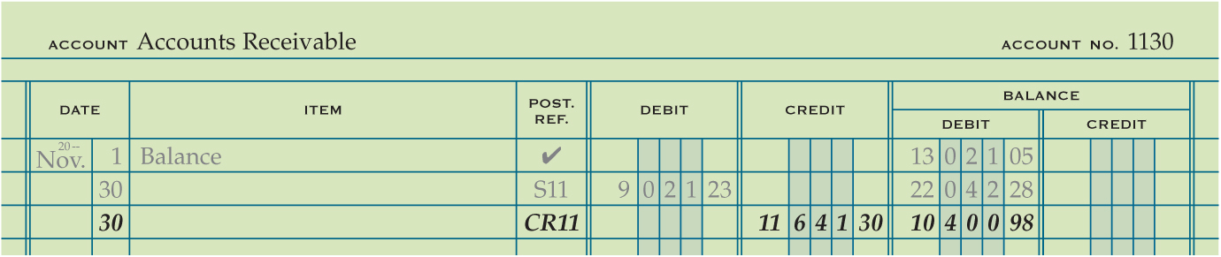
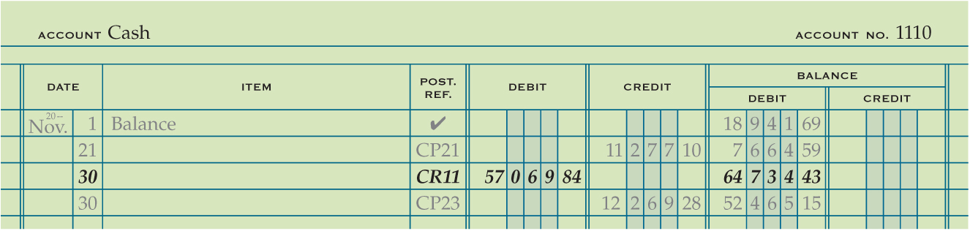
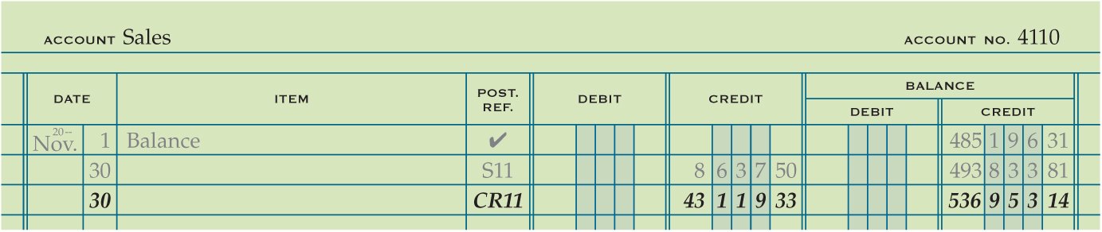
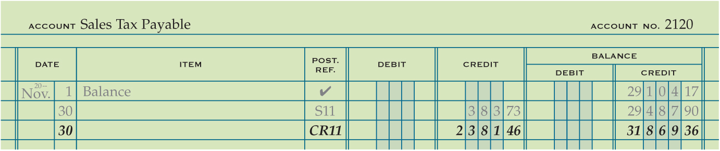
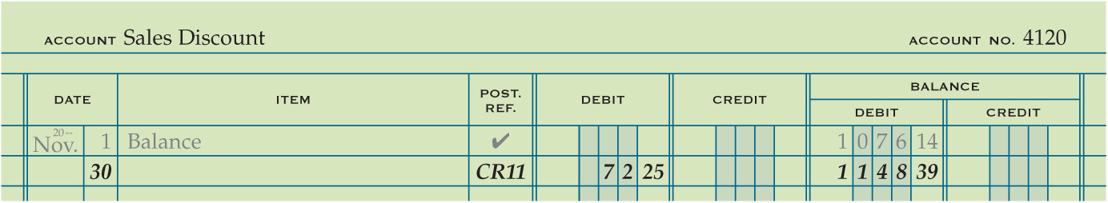
Posting Special Amount Column Totals of a Cash Receipts Journal to a General Ledger
Lesson 10-3
LO6
2
Journal Number
Date
1
Debit or Credit
3
Account Number
5
4
Account Balance
5
5
5
5
1
2
3
4
1
2
3
4
1
1
2
2
3
3
4
4

Slide 42
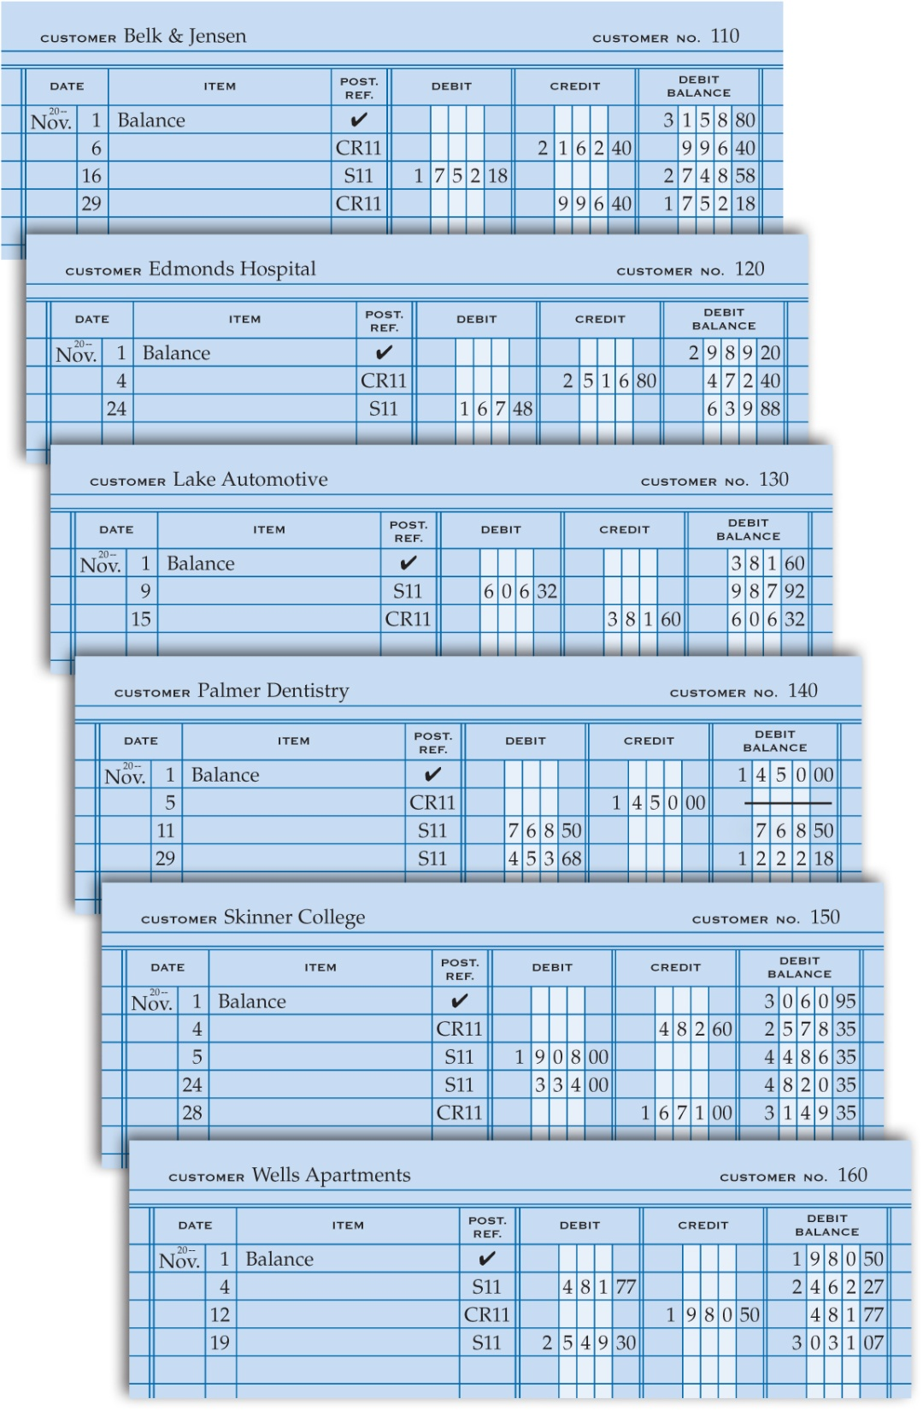
Completed Accounts Receivable Ledger
Lesson 10-3
LO6

Slide 43
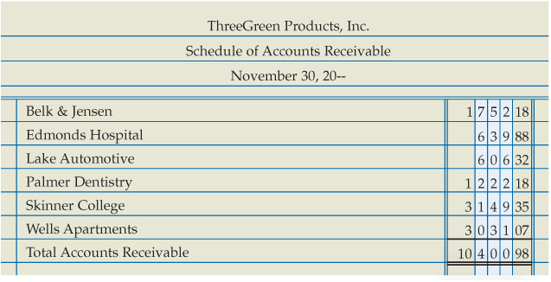
Proving the Accounts Receivable Ledger
Lesson 10-3
LO7
A listing of customer accounts, account balances, and total amount due from all customers is called a schedule of accounts receivable.
Some businesses call the listing the accounts receivable trial balance.

Slide 44
Lesson 10-4 Audit Your Understanding
Lesson 10-4
1. From which column of the cash receipts journal are amounts posted individually to the accounts receivable ledger?
ANSWER
Accounts Receivable Credit column

Slide 45
Lesson 10-4 Audit Your Understanding
Lesson 10-4
2. What is another name for the schedule of accounts receivable?
ANSWER
Accounts receivable trial balance

Slide 46
Work Together 10-4 On You Own 10-4
Work Together
10-1 thru 10-4 work (Excel)
Modeled
Page 309
Use
All 3 tabs
On Your Own
10-1 thru 10-4 own (Excel)
Complete
Page 309
Use
All 3 tabs

Slide 47
Application Problems
10-1 thru 10-4 Application Problem
Excel
10 Mastery Problem
Peachtree
10 Challenge Problem
Peachtree

Slide 48
Unit 10 Assessment
Unit 10 Review (ExamView)
90 % or Greater
5 Point Bonus on Unit 1 Concept Quiz (20% Bonus)
Unit 10 Part 1 Quiz (ExamView)
Concepts – 25 Questions (25 Points)
Unit 10 Part 2 Quiz (Excel)
Skills (30 Points)

